Slide 1
Course Introduction, Test Driven C♯
Rasmus Lystrøm
External Associate Professor
ITU

Slide 2
Me
Rasmus Lystrøm, rasmus@lystroem.dk
39 yrs. Old
Wife Katrine, married for 2 years
Daughters: Alma, 8.
Laura, 1
From Aarhus
Live in Vanløse
2013
Consultant @ Microsoft
2011-2013
Teacher @ DTU
2008-2012
M.Sc. IT @ ITU
Thesis: Forecalc – Developing a core spreadsheet implementation in F♯
1998-2001
B.Sc. Warfare @ Hærens Officersskole
2007-2016 d&n
2001- Lystrøm ApS
2013-
Danish Army (Reserve)
Captain
1996-2008
Danish Army
1st Lieutenant

Slide 3
Agenda
TDD
.NET and the C♯ language
Visual Studio 2015
Test Driven C♯

Slide 4
Test-Driven Development
What?
Why?
How?

Slide 5
RED-GREEN-REFACTOR
How?
[Pass]
[Start]
Add a test
Run the tests
[Fail]
[Fail]
Make a little change
Run the tests
[Pass, Development stops]
[Pass, Development Continues]

Slide 6

A brief introduction

Slide 7
.NET Framework
.NET offers multiple languages, a large class library, driven by a virtual machine
VB
C♯
F♯
C++
…
Your Application
.NET Framework Class Library (FCL)
Common Language Runtime (CLR)
Operating System
Hardware

Slide 8
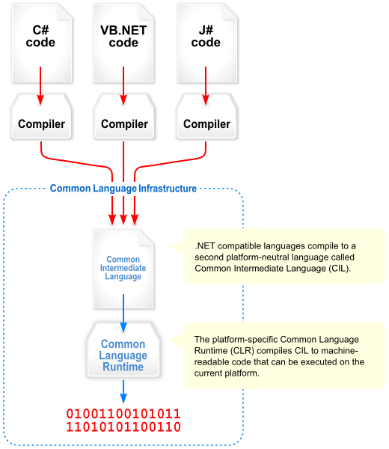
.NET Framework Compilation
C# code
VB code
F# code
Now called Microsoft Intermediate Language (MSIL)

Slide 9
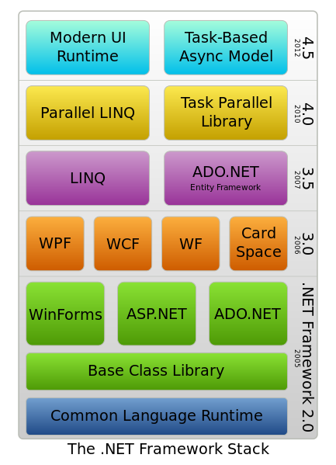
.NET Framework
Versions
1.0 Visual Studio .NET (2002)
1.1 Visual Studio .NET 2003
2.0 Visual Studio 2005
3.0 (2006)
3.5 Visual Studio 2008 (2007)
4.0 Visual Studio 2010
4.5 Visual Studio 2012
4.5.1 Visual Studio 2013
4.5.2 (2014)
4.6 Visual Studio 2015
4.6.1 (2015)
4.6.2 (2016)
.NET Core 1.0 (2016)

Slide 10
C♯
C♯ is intended to be a simple, modern, general-purpose, object-oriented programming language.
Ecma International (2006)

Slide 11
C♯
Language Basics
Show me the CODE!!!

Slide 12
Naming Conventions
Composed names
currentLayout, CurrentLayout
Variables and fields
vehicle, leftElement
Private fields
_vehicle, _leftElement
Methods
CurrentVehicle(), Size()
Properties
Pi, Name, Size
Classes
MyClass, List<T>
Interfaces
IException, IObserver
http://msdn.microsoft.com/en-us/library/ms229002(v=vs.110).aspx

Slide 13
Value Types can never be null!
Value Types
Holds a value – assignment copies the value
Struct
Numeric types
Integral types
Floating point types
Decimal
bool
Enumeration
User defined structs
Integral
byte, sbyte,
short, ushort,
Char,
int, uint,
long, ulong
Floating point
float
Double
Decimal
decimal
enum Days {Sat, Sun, Mon, Tue, Wed, Thu, Fri};
System.Guid
System.Drawing.Point
System.DateTime
System.Numerics.BigInteger
System.Numerics.Complex

Slide 14
Value Types
int age;
System.Int32 age;
Int32
+MaxValue
+MinValue
System.Object
+Equals()
+ComparesTo()
+ToString()
+GetHashCode()
+GetType()
+Parse()
+TryParse()
…
System.ValueType

Slide 15
Value Types
Memory
int i1 = 42;
i1: int
i2: int
int i2 = i2;
ReferenceEquals is always false

Slide 16
Reference Types
Memory
var car = new Vehicle();
Vehicle: object
Vehicle audi = null;
audi = car;

Slide 17
Reference Type Equality
ReferenceEquality:
Person p1 = new Person(“Joe”);
Person p2 = new Person(“Joe”);
Person p3 = p2;
ReferenceEquality(p1, p2) = false
ReferenceEquality(p2, p3) = true;
In C# the == operator is “equal” to reference equality. (Can be overridden)
Value Equality (for reference types)
p1.Equals(p2) = true; (Can be overridden)

Slide 18
Value Type Equality
Equals the same as for reference types
object.ReferenceEquality will always return false for value types
== operator is overridden so it does value equality

Slide 19
String Interning
string a = "Peter";
string b = "Peter";
a.Equals(b); ==> true
a == b; ==> true
object.ReferenceEquals(a, b); ==> true
String Interning
The String Type is Immutable – assigning creates a new value…

Slide 20
Local Variable Type Inference
var identifier = expression;
var is a keyword, not a type

Slide 21
Enumeration
public enum Day { Mon, Tue, Wed, Thu, Fri, Sat, Sun }
public enum Month : uint { Jan = 1, Feb, Mar, }
public enum Color : uint { Red = 0xFF0000,
Green = 0x00FF00,
Blue = 0x0000FF }
Vehicle car = new Vehicle();
car.Color = Color.Red;
Console.Write(Day.Mon);

Slide 22
Array stuff
int[] intArray = new int[4];
double[,] doubleArray = new double[4, 5];
int[,] array1 = {{1,2],{3,4]};
int value1 = intArray[0];
double value2 = doubleArray[0,1];
Console.WriteLine(array1[1,1]);
Arrays are 0-based

Slide 23
String stuff
public static void Main(string[] args)
{
var name = "Anders";
var argument = args[0];
Console.WriteLine(10 + " hello " + name + argument);
}
Automatic conversion

Slide 24
Compile from Command Line
Developer Command Prompt for VS2015:
C:\[program_dir]> csc

Slide 25
Command Line Options
Compiler Option | Short Form | Description
/target:exe /target:library | /t:exe /t:library | Compile to an executable (.exe file) (default) Compile to a library (.dll file)
/reference:Lib.dll | /r:Lib.dll | Include reference to library Lib.dll
/main:MyClass | /m:MyClass | Method Main in MyClass is the entry point
/debug | /d | Add debugging information
C:\Program Files (x86)\Microsoft Visual Studio 14.0>csc /?

